Slide 1
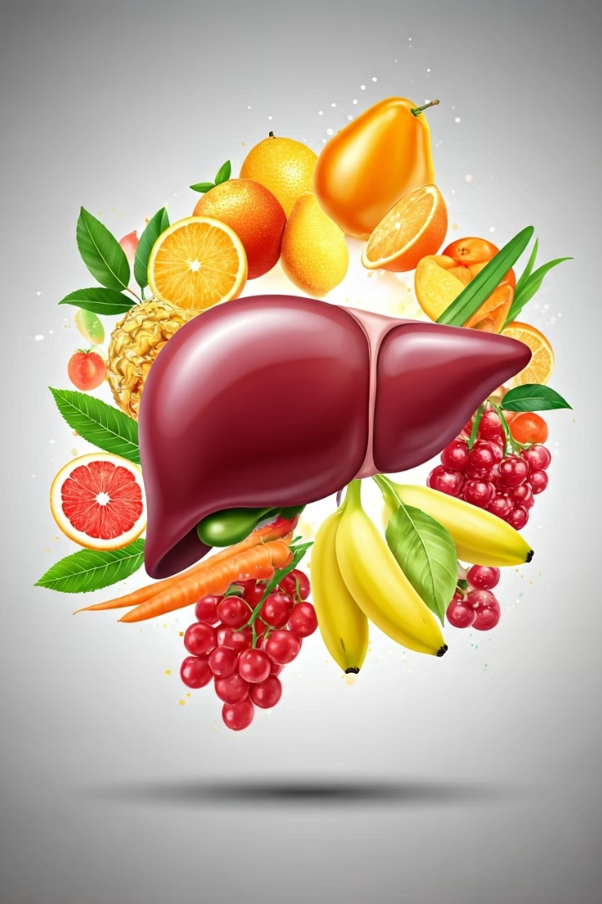

Fatty Liver Prevention Methods
What is Prevention?
Prevention means doing things that stop a disease from happening. In fatty liver, prevention means keeping your liver healthy so that fat doesn't build up.
by Ram N Java

Slide 2
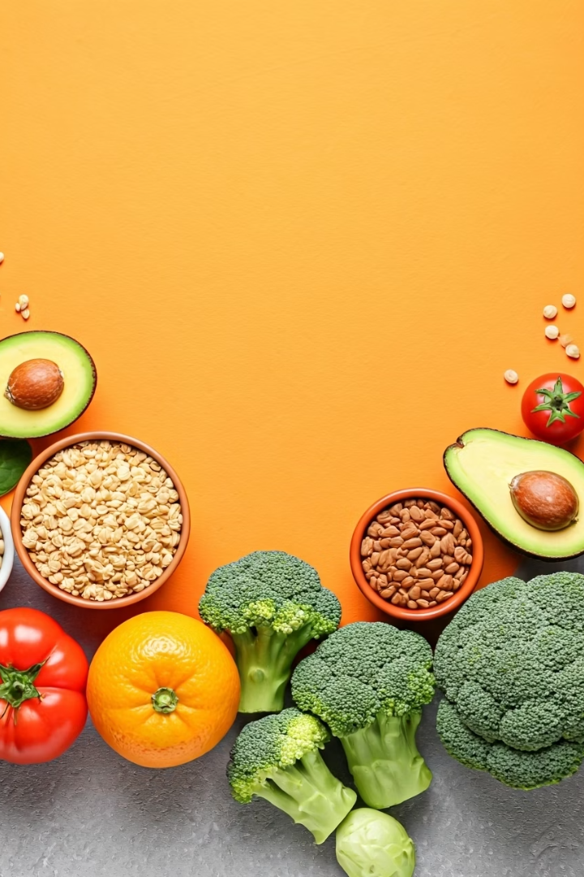




Healthy Diet for Liver Health
Eat more healthy foods
Eat more fruits, vegetables, whole grains, and lean proteins.
Avoid unhealthy options
Avoid fried food, junk food, fast food, too many oily items and too much sugar.
Reduce refined carbohydrates
Reduce white rice, white bread, and sugary drinks like cola and juice.
Choose better fats
Choose healthy fats like nuts, seeds, olive oil, and fish.

Slide 3

Weight Management and Exercise
Maintain a Healthy Weight
Exercise Regularly
Do at least 30 minutes of walking, cycling, or any physical activity daily.
If you're overweight, try to lose weight slowly.
Even losing 5 to 10% of your body weight can help your liver.
Exercise helps burn fat and keeps your liver healthy.

Slide 4
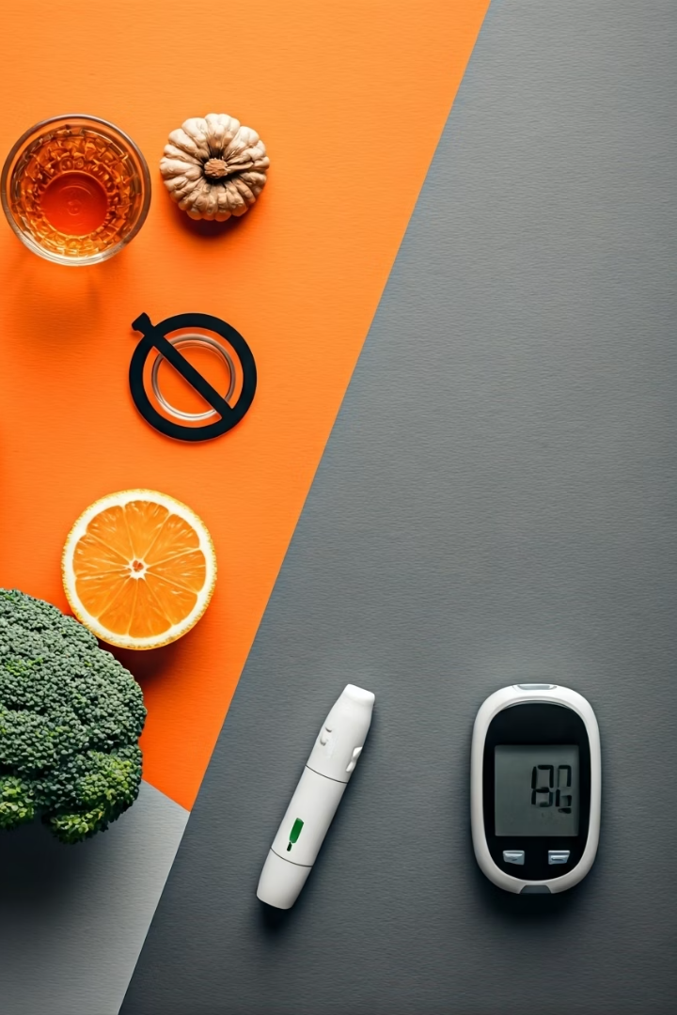
Alcohol and Blood Sugar Management
Avoid Alcohol
Alcohol can damage liver cells and increase fat in the liver.
If you don't drink, don't start. If you do, try to stop or reduce it.
Control Diabetes and Blood Sugar
If you have diabetes or high blood sugar, keep it under control with medicine, diet, and exercise.

Slide 5
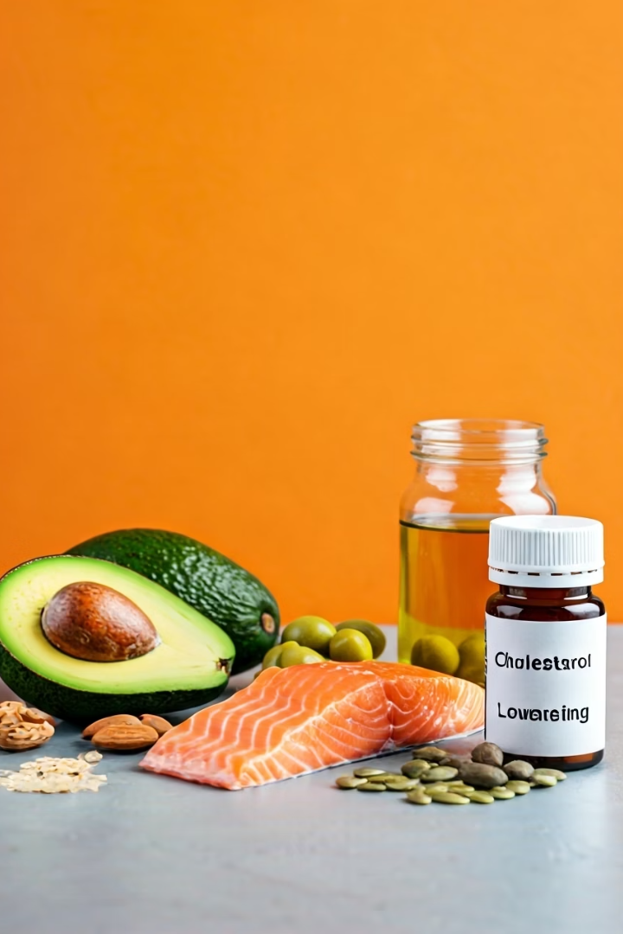


Cholesterol Management and Medication Safety
Lower Cholesterol
Avoid foods that raise bad cholesterol (like fried foods, butter, red meat).
Use healthy oils (like olive oil or sunflower oil) in small amounts.
Avoid Unnecessary Medicines
Some medicines can harm the liver if taken too much or without advice.
Always check with a doctor before taking new medicines.

Slide 6



Regular Check-ups and Hydration
Get Regular Health Check-Ups
Drink More Water
Water helps your body and liver flush out toxins.
Do liver tests if you are at risk (obese, diabetic, etc.).
Try to drink 6 to 8 glasses every day
Early detection can help you reverse fatty liver before it gets serious.

Slide 7










Simple Prevention Summary
Healthy Lifestyle
A healthy lifestyle today means a healthy liver tomorrow.
Overall Health
Take care of your overall health
Avoid Alcohol
Avoid alcohol
Stay Active
Stay active
Eat Well
Eat well
In Simple Words
To prevent fatty liver, you should eat well, stay active, avoid alcohol, and take care of your overall health.

